Slide 1
Health and Safety Aspects of Oil Spill Response
CGPRT(W) : Ensuring Clean Seas and Coasts in Western Region ……

Slide 2
Objective
To understand the health and safety aspects of oil spill response including risk assessments, site safety, PPE and emergency response.
CGPRT(W) : Ensuring Clean Seas and Coasts in Western Region ……

Slide 3
Health and Safety Aspects
Know the health and safety considerations and precautions with respect to:
  Spilled product
  Working environment
  Equipment
  Transportation
  Decontamination
CGPRT(W) : Ensuring Clean Seas and Coasts in Western Region ……

Slide 4
Health and Safety Aspects
There are multiple hazards when responding to an oil spill:
  Chemical
  Physical
  Environmental
  Wildlife
  Other
CGPRT(W) : Ensuring Clean Seas and Coasts in Western Region ……

Slide 5
Safety of the General Public
Protection of the general public is an important consideration:
may require provision of advice on the presence or absence of risks posed to the general public following an oil spill incident
may require evacuation from areas likely to have hydrocarbon vapours present
may require enforcing strict controls on access to contaminated areas to minimize direct contact with oil
CGPRT(W) : Ensuring Clean Seas and Coasts in Western Region ……

Slide 6
Chemical Hazards from Spilled Product
Some compounds found in oil can be toxic
Responders must avoid exposure to these compounds
Typical exposure routes:
  Inhalation
  Ingestion
  Contact
  Absorption
CGPRT(W) : Ensuring Clean Seas and Coasts in Western Region ……

Slide 7
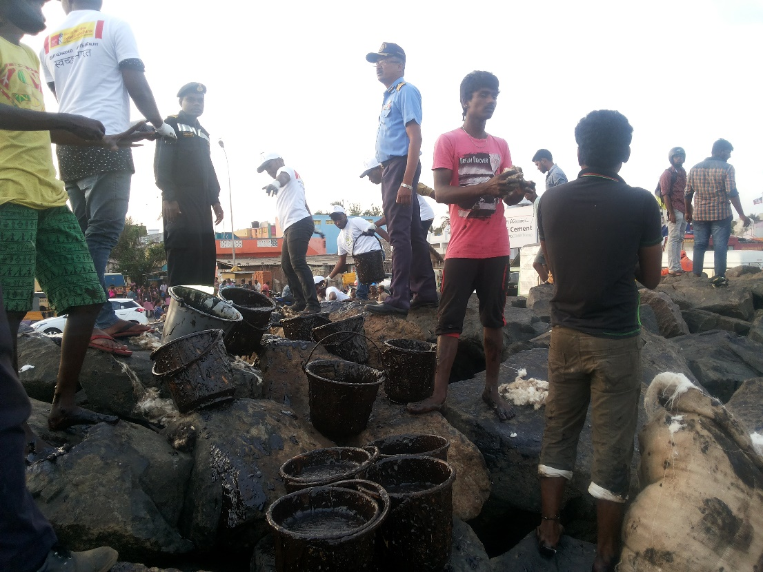
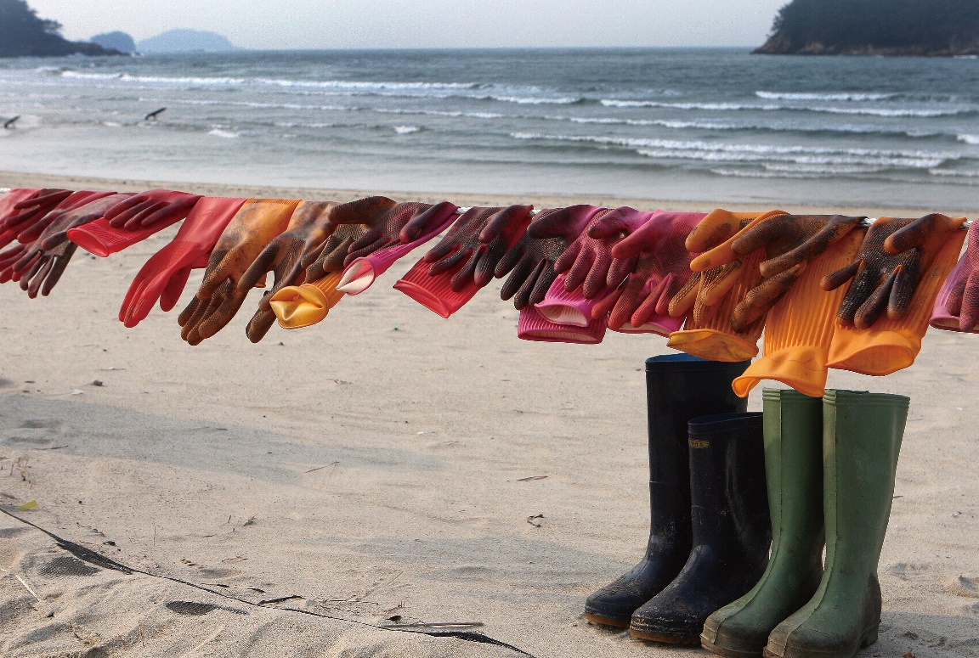
Chemical Hazards from Spilled Product
CGPRT(W) : Ensuring Clean Seas and Coasts in Western Region ……

Slide 8
Chemical Hazards from Spilled Product
Inhalation is a very important exposure route initially as light ends will evaporate:
  Hydrogen Sulphide
    Rotten egg smell
    Mild symptoms: dizziness, headache, eye irritation
    Severe symptoms: Dulled sense of smell to no sense of smell, loss of consciousness, death
  Benzene
    Known carcinogen
    Irritation, headache, dizziness.
CGPRT(W) : Ensuring Clean Seas and Coasts in Western Region ……

Slide 9
Precautions
To avoid inhalation:
    Conduct air monitoring
    Avoid confined spaces (caves, low-lying areas, tanks, etc.) until deemed safe
    Work upwind from spill source
    Wear respiratory protection
        Never rely on sense of smell
CGPRT(W) : Ensuring Clean Seas and Coasts in Western Region ……

Slide 10
Chemical Hazards from Spilled Product
Ingestion
  While eating, drinking (always wash first!)
  Breathing liquid into lungs from mist during pressure washing or while using cleaning agents
  Falling into product (swimming)
Absorption
  Direct skin contact resulting in compounds entering the blood stream (may be a long term effect)
CGPRT(W) : Ensuring Clean Seas and Coasts in Western Region ……

Slide 11
Precautions
Use proper decontamination procedures before eating/drinking/smoking/taking breaks.
Wear PPE properly as directed.
Use face shields, masks and filters as directed when pressure washing.
Remove oil from skin immediately if contact does occur.
Seek medical attention if ingested or product gets into the eyes.
CGPRT(W) : Ensuring Clean Seas and Coasts in Western Region ……

Slide 12
Precautions
Know the properties and characteristics of the spilled product.
Know the general hazards of the spilled product.
Safety data sheet.
CGPRT(W) : Ensuring Clean Seas and Coasts in Western Region ……

Slide 13
Spilled Product
Safety data sheet information
  Product and company
  Hazards identification
  Composition/Information on ingredients
  First aid measures
  Fire fighting measures
  Accidental release measures
  Handling and storage
  Exposure controls/Personal protection
  Physical and chemical properties
  Stability and reactivity
  Toxicological information
  Ecological information
  Disposal considerations
  Transport information
  Regulatory information
  Other information
CGPRT(W) : Ensuring Clean Seas and Coasts in Western Region ……

Slide 14
Symptoms of Toxic Exposure
Skin rashes/allergies/sores
Changes in sense of smell
Shortness of breath/ asthma/cough
Headaches
Chest pains
Nausea/vomiting
Weakness/tremors
Unusual fatigue or new sleeping difficulties
Unusual irritability
CGPRT(W) : Ensuring Clean Seas and Coasts in Western Region ……

Slide 15
Physical Hazards from Spilled Product
Fire/Explosion
Oil is a flammable product!
Precautions
  Avoid ignition sources
    Smoking/lighters and matches
    Electrical equipment
    Phone usage during response (including camera)
  Conduct air monitoring
  Establish site control
CGPRT(W) : Ensuring Clean Seas and Coasts in Western Region ……

Slide 16
Physical Hazards in Work Environment
Field work
Main hazards:
  Water hazards/drowning
  Slip, trips and falls
  Ergonomic stresses
  Fatigue
  Poor weather conditions
  Hypothermia/frostbite
  Heat stress and heat exhaustion
CGPRT(W) : Ensuring Clean Seas and Coasts in Western Region ……

Slide 17
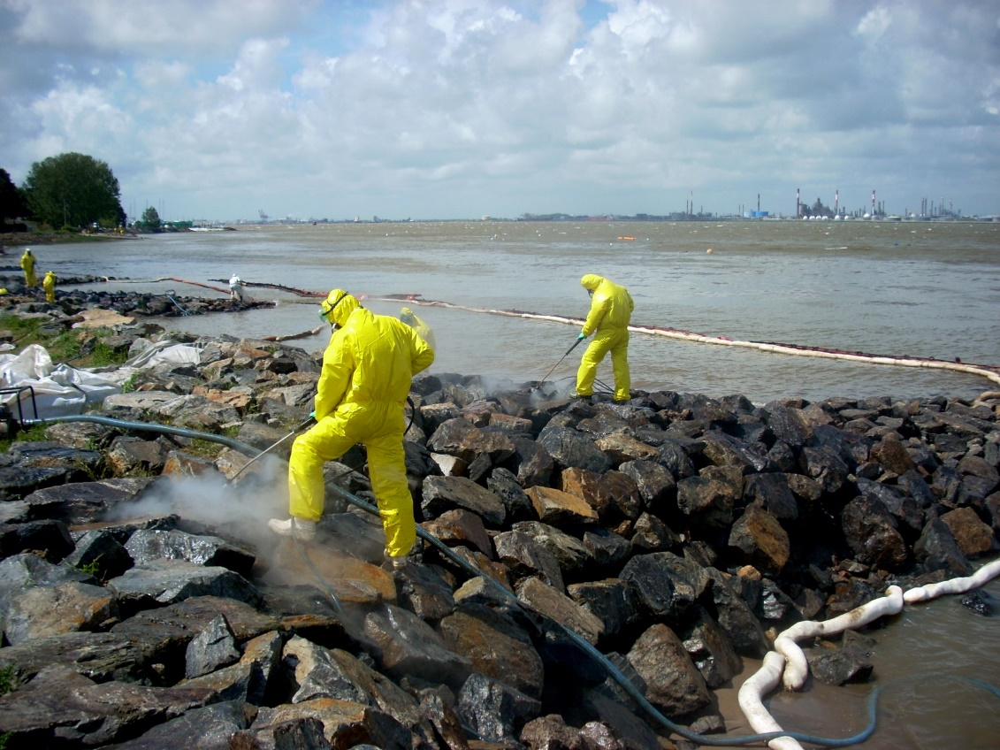
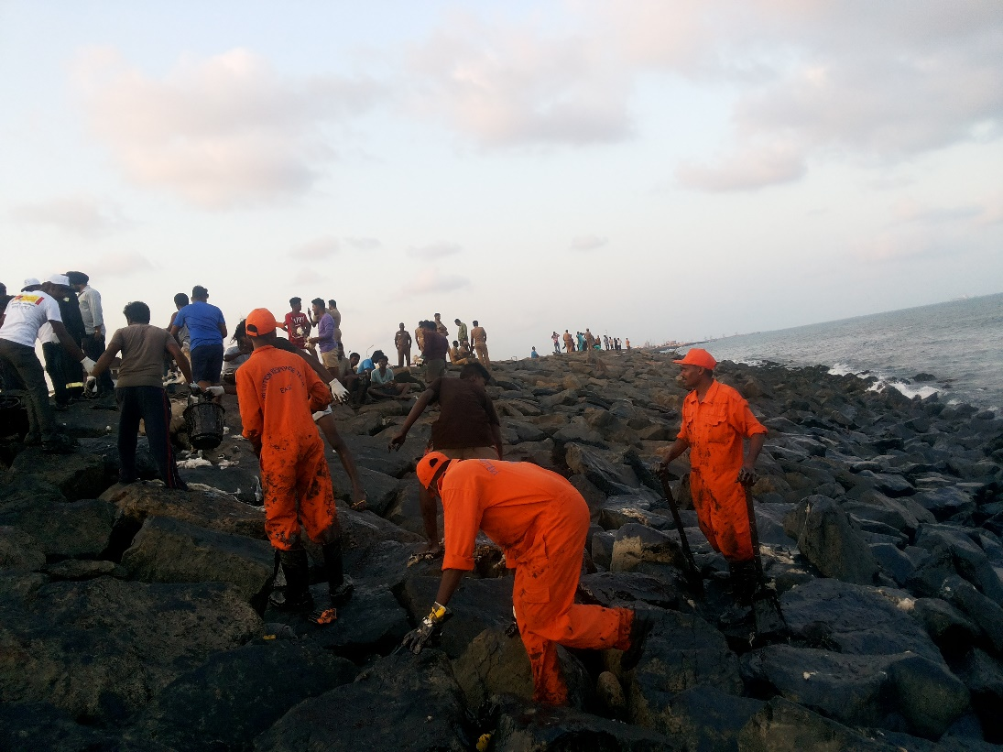
Physical Hazards
Source: CEDRE
CGPRT(W) : Ensuring Clean Seas and Coasts in Western Region ……

Slide 18
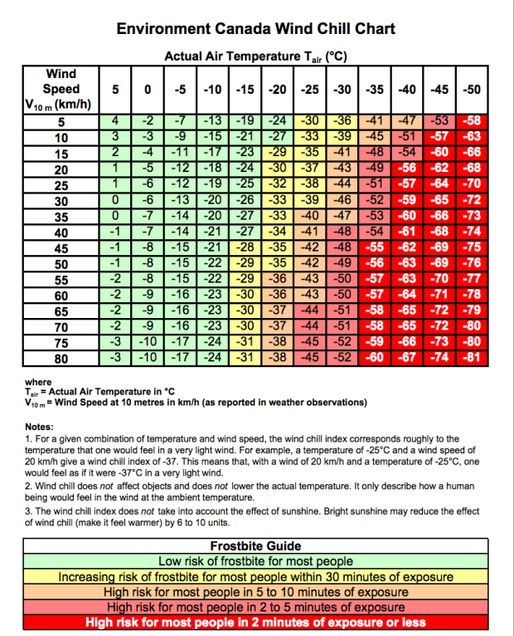
Physical Hazards – Cold Related
CGPRT(W) : Ensuring Clean Seas and Coasts in Western Region ……

Slide 19
Precautions
Take sufficient breaks
Obey all health and safety instructions
Wear appropriate PPE at all times
Use proper lifting and carrying procedures
Never work alone
Keep situational awareness
  Concentrate on what you are doing now, not what you are going to do!
CGPRT(W) : Ensuring Clean Seas and Coasts in Western Region ……

Slide 20
Wildlife Hazards in Work Environment
Wildlife – especially in remote locations, e.g.
  Birds
  Bears
  Coyotes
  Snakes
  Crocodiles/alligators
Insects - stings
Domestic dogs
Poisonous plants
CGPRT(W) : Ensuring Clean Seas and Coasts in Western Region ……

Slide 21
Wildlife Response Hazards
During search and collection of oiled wildlife
  Slips, trips and falls
  Lacerations/broken bones
  Bites/cuts/scratches/stab wounds
  Strains
  Heat/cold related
  Zoonotic diseases/parasites
  Working near water
  Working in proximity to heavy machinery (clean-up)
CGPRT(W) : Ensuring Clean Seas and Coasts in Western Region ……

Slide 22
Wildlife Response Hazards
During wildlife rehabilitation
  Slips, trips and falls
  Lacerations/broken bones
  Bites/cuts/scratches/stab wounds
  Strains
  Zoonotic diseases/parasites
  Skin irritations due to allergies (latex gloves, etc.)
  Skin puncture from syringes
  Burns/shock from heaters/electrical equipment
CGPRT(W) : Ensuring Clean Seas and Coasts in Western Region ……

Slide 23
Wildlife Handling Precautions
Use proper decontamination procedures before eating/drinking/taking breaks.
Wear PPE properly as directed.
Take sufficient breaks.
Use proper lifting procedures.
Proper ventilation.
Follow directions for disease control.
Only trained personnel should attempt to capture or treat wildlife.
CGPRT(W) : Ensuring Clean Seas and Coasts in Western Region ……

Slide 24
Other Hazards in Work Environment
Transportation
  Road
  Helicopters
  Fixed wing aircraft
  Boat and water operations
Noise exposure
Drugs and alcohol
Allergies
Firearms, munitions, weapons
Biohazards on shorelines (sharps)
CGPRT(W) : Ensuring Clean Seas and Coasts in Western Region ……

Slide 25
Safety Plan
A safety plan must be developed for the response.
Applicable to all response activities:
  On water
  Aerial
  Shoreline
  Command post
Implementation of safety plan is the responsibility of the incident commander/supervisor.
CGPRT(W) : Ensuring Clean Seas and Coasts in Western Region ……

Slide 26
Key Elements of a Safety Plan
Evaluate potential hazards
  Safe task analysis
Implement essential safety requirements:
  Establish site control
  Safety training/briefings
  Equipment
Reporting
CGPRT(W) : Ensuring Clean Seas and Coasts in Western Region ……

Slide 27
Evaluate Potential Hazards
Conduct on-site safe tasks analysis:
  Identify hazards
  Identify operations
Must be done on every site and every time clean-up crew arrive on site
Evaluate risks and mitigation measures
CGPRT(W) : Ensuring Clean Seas and Coasts in Western Region ……

Slide 28
Implement Essential Safety Requirements
Site control
Limit access to essential personnel
  Command post
  Clean-up sites
  Identification for workers
All workers must be briefed on site safety plan
Identify first-aid workers on site
CGPRT(W) : Ensuring Clean Seas and Coasts in Western Region ……

Slide 29
Implement Essential Safety Requirements
Safety training/briefings:
All personnel must be trained for the task they need to accomplish
Basic on-site training
Daily site safety briefings (weather, objectives, etc.)
CGPRT(W) : Ensuring Clean Seas and Coasts in Western Region ……

Slide 30
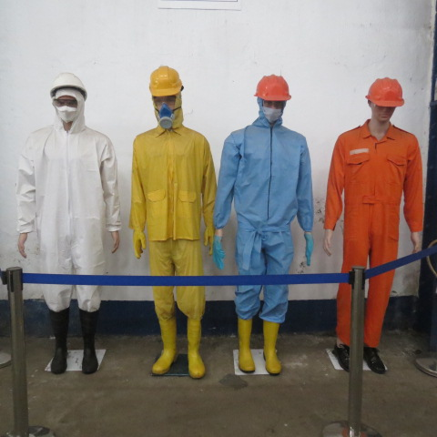
Implement Essential Safety Requirements
CGPRT(W) : Ensuring Clean Seas and Coasts in Western Region ……

Slide 31
Implement essential safety requirements
Equipment:
Safety equipment must be provided
  Protective clothing
Basic facilities must be in place:
  First aid
  Sanitation
  Rest areas
CGPRT(W) : Ensuring Clean Seas and Coasts in Western Region ……

Slide 32
Implement Essential Safety Requirements
Communications in place
Don’t forget specific hazards:
  On-water operations, crane usage; entry to confined spaces; helicopter operations
CGPRT(W) : Ensuring Clean Seas and Coasts in Western Region ……

Slide 33
Safety Training/Briefings
Site safety policy
Chain-of-command on site
Safety procedures:
  General safety
  Procedures for specific operations/equipment
Emergency procedures:
  Personal injury; evacuation; fire-fighting
CGPRT(W) : Ensuring Clean Seas and Coasts in Western Region ……

Slide 34
Any questions?
CGPRT(W) : Ensuring Clean Seas and Coasts in Western Region ……

